Slide 1
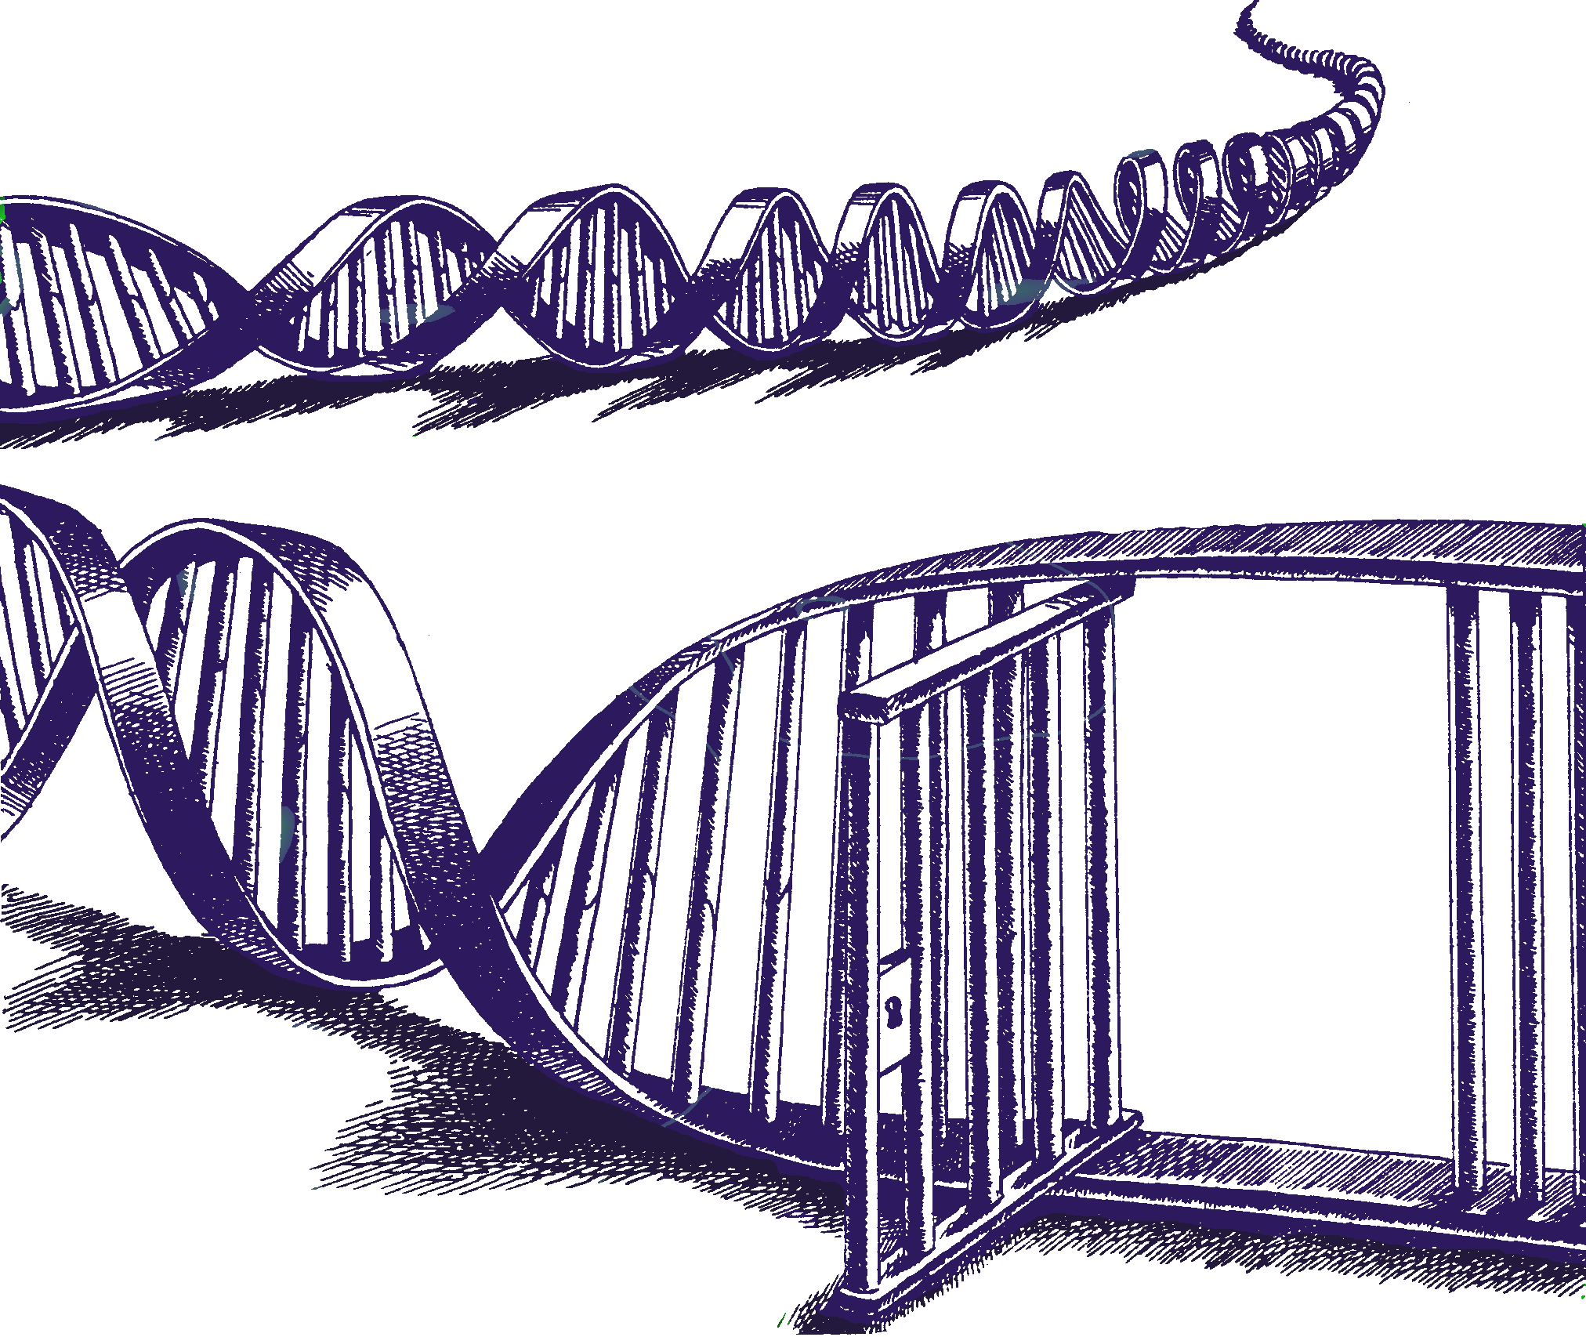
Continuous insights into mixtures
DNA·VIEW Mixture Solution – Lessons from program development and testing
Charles Brenner, Ph.D.
Purveyor of forensic mathematics, DNA∙VIEW,
Senior Research Fellow at UC Berkeley Human Rights Center
http://dna-view.com c@dna-view.com

Slide 2
Outline
Mixtures – past & future
Why continuous model?
  “Exclusion” no sense
How continuous model?
  Dropout → 2-dimensional data
  LR from first principles
Puch-Solis-like model
  Hypotheses → expected profile ± stochastic variation
  Fit of expected profile to observed mixture → Likelihood of hypothesis
DNA⋅VIEW® Mixture Solution™
  Windows version of full DNA⋅VIEW under development
  Initial release – mainly Mixture Solution – expected soon

Slide 3
Mixtures – past & future
What –
  traditional (rape, murder(fingernail), …)
  Now (gun grip, ski mask, grab touch)
    Lots more mixtures
    Cases with many suspects
    Mixtures with many possible references, many possible contributor #s
History
  Binary – “cliffs”
    Exclusion, etc.
  Rounding the corners
    Thresholds (60% rule. Stochastic). Still fitting square pegs to round holes.
  Continuous models – truly round corners

Slide 4
“Exclusion” method & nonsense
Very plausible contributor
(p+q+r)²
(inclusion formula)
The Cliff:
  black & white
The Reality:
  shades of grey
P,Q,R
Impossible contributor
Genotypes “included” in mixture
genotypes excluded from mixture
Genotype axis
Very plausible contributor
X
(p+q+r)²
Impossible contributor
genotypes included
Inclusion needs dropout or imagination.
excluded genotypes

Slide 5
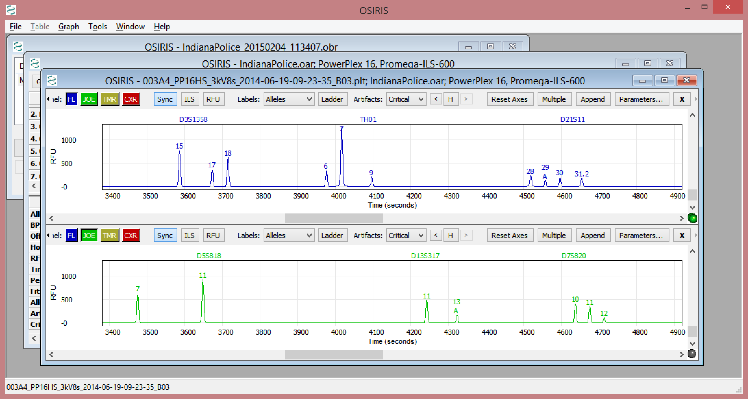
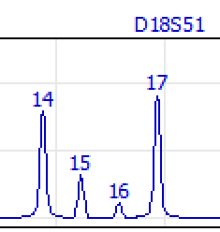
Continuous what?
RFU dimension (continuous)
Second Dimension = RFU
  Realities of rfu variation from
    dosage, stochastic variation, allele stacking, stutter
  RFU continuity →
    Cliff crumbles to slope.
      Exclusion method model is too flawed for casework.
“Mixture” defined as
  observed alleles (as in the past)
  AND observed heights.
D3 TH01 D21 D18
Allele size dimension
(discrete)
Very plausible contributor
Impossible contributor
Genotypes

Slide 6
Stochastic variation model
1000 rfu ±18%
or ±180rfu
1 σ of peak height variation
Simple model of peak height ratios:
Each allele varies independently per the stochastic model.
Thus PHR variation follows from per-allele stochastic variation;
no extra “moving part” needed.

Slide 7
Coherent dropout model
Definitions –
  Analytical threshold (e.g. 35 rfu) means
    Level below which data not collected.
  Dropout (at an allele position) means
    No signal above analytic threshold
Consequence
  Dropout defined in terms of the stochastic model:
  Pr(dropout) = Pr(Stochastic variation from expected rfu to below Analytic Threshold)
Missing allele

Slide 8
DNA·VIEW® Mixture Solution
Evidential value (likelihood ratio) for DNA mixtures
  Evaluates peak heights, dropout, drop-in, stutter
  “Continuous” method
    Unified model → conceptual simplicity
  Fast, automatic
    Evaluate and compare many hypotheses
peak heights
dropout
drop-in
stutter

Slide 9
Continuous model taxonomy
Constructive approach (Mixture Solution, Puch-Solis et al paper)
Likelihood(s) from definition:
Pr(mixture | assumed references & # of unknowns &c)
Robust with respect to parameter choices
  Mixture Solution only program to see NIST13 exercise #5 as 4-person.
Deconvolution approach (TrueAllele, STRmix(?))
First, guess component genotypes (references set aside).
Defense & Prosecution must coordinate assumptions, e.g. # contributors.

Slide 10
LR from independent Likelihoods
Benefits
Log Pr(…_{p})
Fair: Unlinks defense and prosecution assumptions
  # of defense contributors
  Defense references or relationships
Fast: 10 Likelihood calculations → up to 90 likelihood ratios
% from A
% from O
Pr(mix |A+O+3rd man)
LR= =
Pr(mix|A+2nd+3rd men)
Log Pr(...H_{d})
65 seconds total time
10 hypotheses
% from A
% from 2nd man
Time (sec)
# of unknown contributors
reference contributors
Notes:
1 Dual peak – can MCMC handle it? They’re coy but I doubt it.
2 Differing #’s of contributors is a non-rare reality; this case exemplifies.

Slide 11
Anti-blackbox Visual Aid
Mixture M as Abby + Oscar + 2 unknown people
Maximum likelihood proportions
Contribution proportions
Racial likelihoods (unknown #1)
Kuwaiti
(for unknown #1)

Slide 12
Model attributes
Biochemical model
  As complicated as necessary
  As simple as possible
    Testing, speed, flexibility, reliability
  Robust “constructive” model
Casework model – exploring
  Many suspects and/or possible hypotheses
  Automatic evaluation compares & ranks the hypotheses
Notes:
Defense friendly stochastic model: 1) Adjust stochastic parameters. 2) ?

Slide 13
Insights
“Allele observed” not well-defined
“Contributor” not well-defined. (Try!)
  “1+ rfu”? – useless
  “Significant flourescence”? – vague
  Prosec/Defense # contributors needn’t jibe
Speed kills (i.e. seconds per hypothesis)
  User convenience
  Development & validation paradigm difference
MCMC not necessary
  Possible to calculate all of 10⁴⁰+ genotypes
Multi-race→ (# races)^{(# unknowns)} calculations

Slide 14
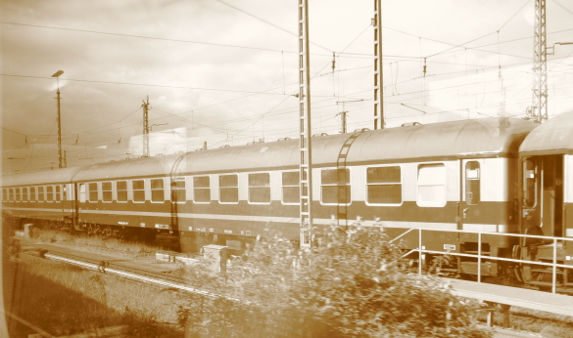
c@dna-view.com
http://dna-view.com

